Slide 1
Building a SAP CAPM Project in SAP Business Application Studio And Implementing SAP DM Standard API Service

Slide 2
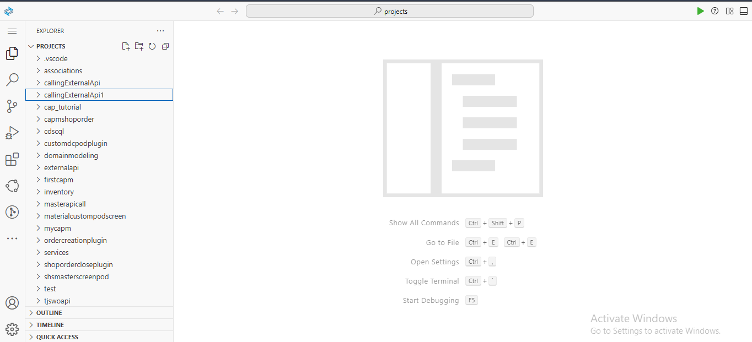
Project Setup:
Open the Business Application Studio, and open the project folder. File->Open Folder, then select projects folder and click on ok.

Slide 3
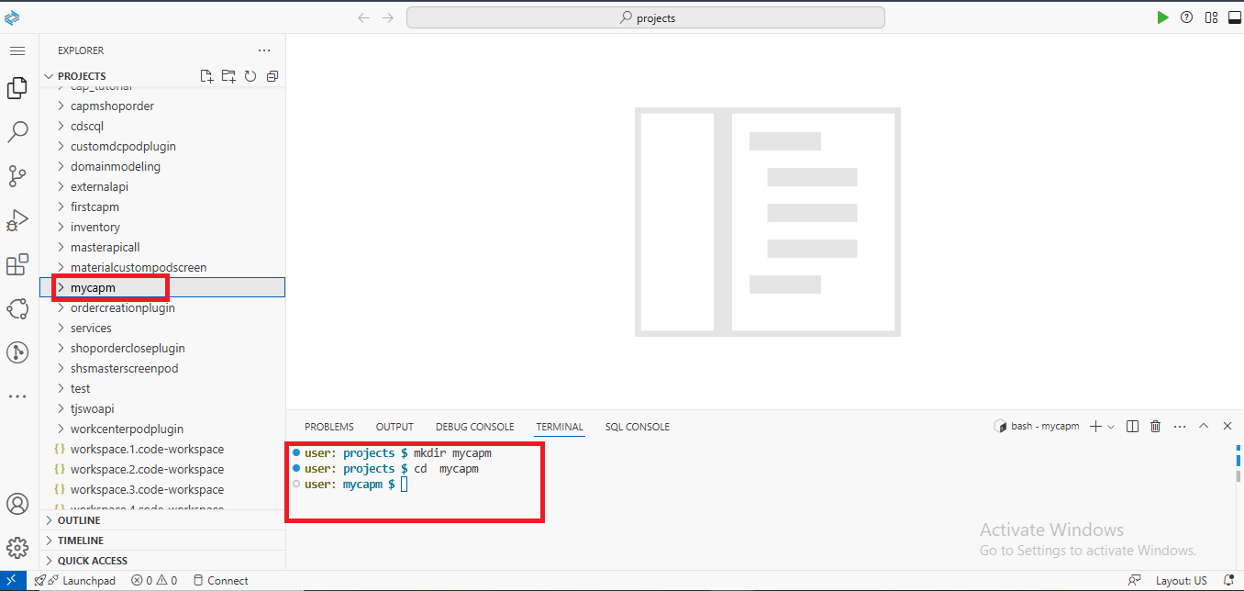
Open the Integrated terminal, change directory to the folder where you want create your CAPM Project or create a new folder inside project folder and change directory to that folder.

Slide 4
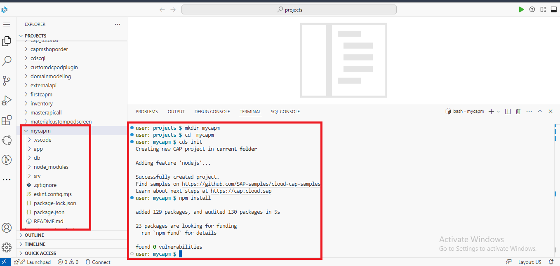
To create CAPM project run the below commands 1. cds init : to initialize the CAPM project by creating the folders like app , db and srv 2. npm install: to install all the node modules.

Slide 5
CAPM Main folders: 1. app 2. db 3. srv
The app folder contains the UI(User Interface), typically built with SAP Fiori or SAPUI5.
The db folder is responsible for defining the data models such as entities and their relationships.
Ex: SQLite, SAP HANA Cloud.
The srv folder contains the service definitions and business logic of the CAPM Project.

Slide 6
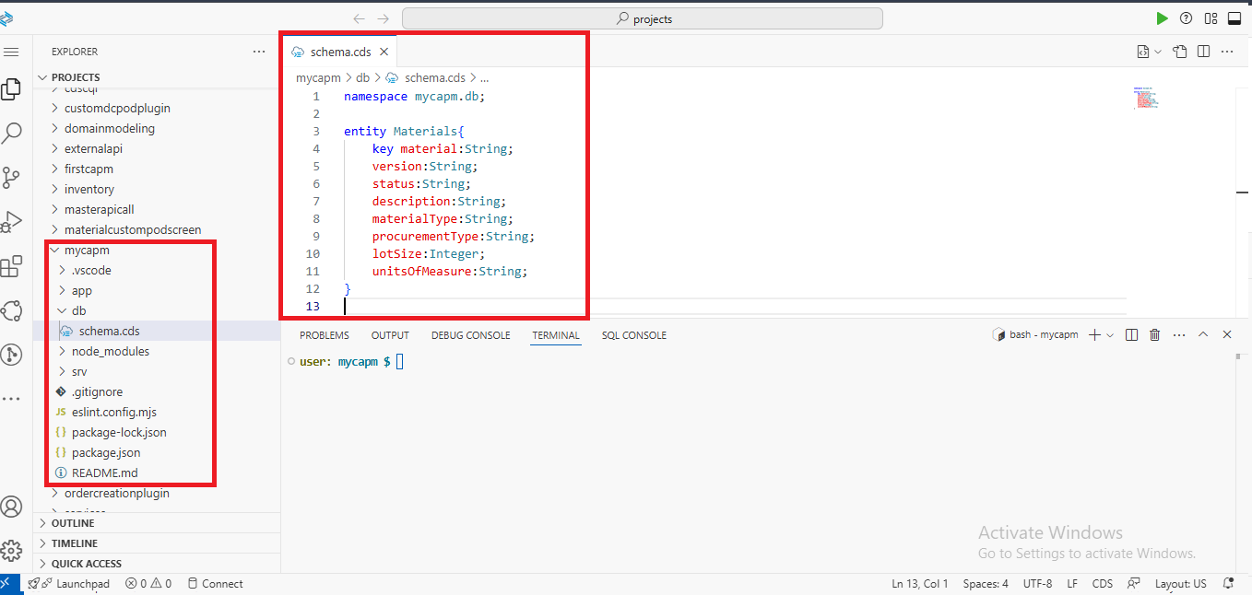
1.Create data-model under db folder:
1. Right click on the db folder and create new file with .cds extension.
Ex: schema.cds
2. Then define the namespace and create the entity with one key(Primary Key).

Slide 7
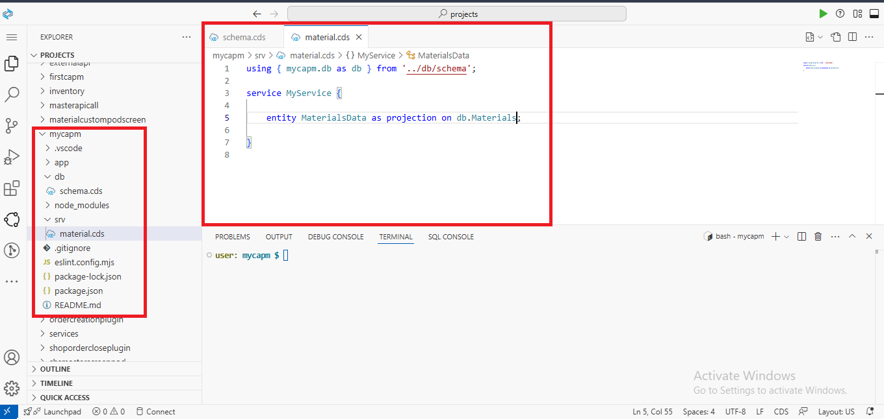
2. Create the Service for defined Entity:
1. Right click on srv folder and create the new file with .cds extension.
Ex: material.cds
2. Import the entity by using “using” keyword and define the path.
3. Then create the service

Slide 8
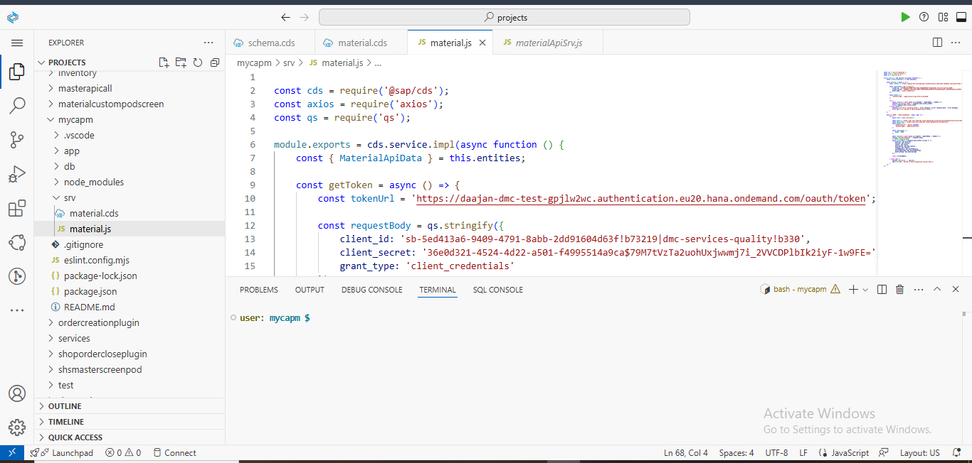
3. Provide the implementation for the created service.
1. Right click on the srv folder and create the new file with .js extention and the file name should be same as service file name.
Ex: 1. material.cds:- the service file name
2. material.js:- the service implementation file name
2. Then provide the implementation for the defined service.

Slide 9
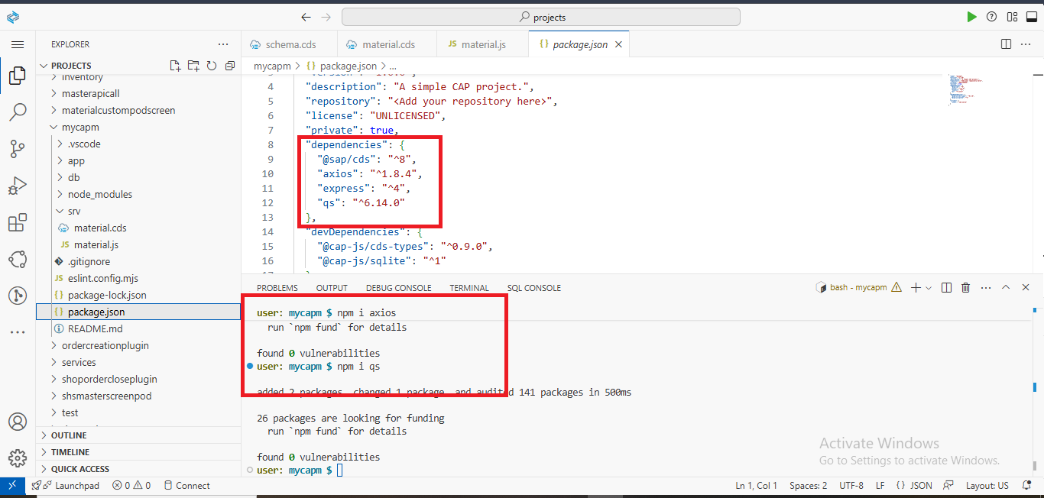
To Call SAP DM API Service we need below packages/dependencies:
To implement nodeJs service , first import axios, cds and qs dependencies run below commands:
1. npm i axios : to handle HTTP requests
2. npm i qs: used to serialize and parse URL query strings. It is commonly used when working with HTTP request that require application/x-www-form-urlencoded data format.
3. Once you run the above commands, you can see the dependencies in the “package.json” file

Slide 10
Now, Call The SAP DM API Service(material.js):
1.Import all the necessary packages
2. Get the Authorization to generate access token for the DM API Service from the Service Instance of SAP Digital Manufacturing Subaccount by creating key, like :
Client Id, client secret, url, subdomain, public-api-endpoint and region.
The sample Access token is look like below:
https://<Subdomain>.authentication.<region>.hana.ondemand.com/oauth/token
3. Then call the DM service by using the above access token:
. First create one service in the Design Production Process
. Then publish the created service to the Manage Service Registry
. And take the URL/Path value of the published service.
. Then merge the URL/Path with the Public-api-end.
. Add this one : &async=false
Now the overall DM API service is look like below: “https://<public-api-endpoint>/<URL/Path>&async=false”
Refer the below code for the entire token generation and Calling API service:

Slide 11
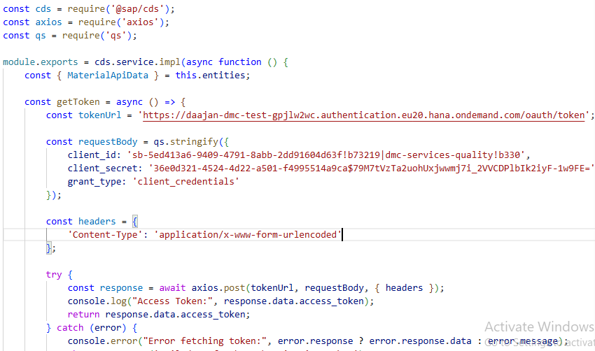
Implementation of material.js:

Slide 12
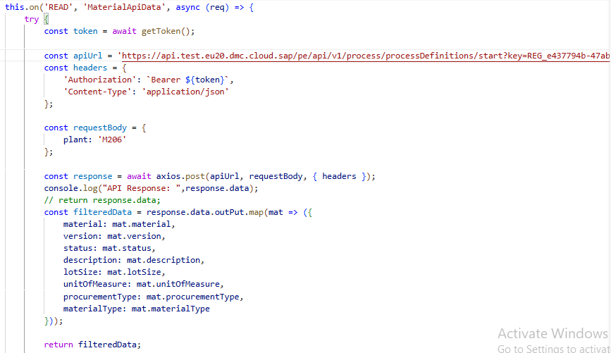
Contd..

Slide 13
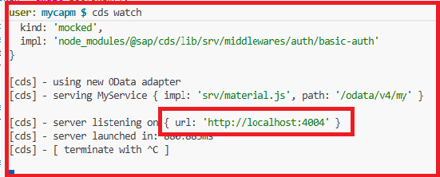
Run The CAPM Project
To run the CAPM project use the below command:
cds watch
. After running the above command, it will generate the one URL click on that one , it will open the by default CAPM Project index page.
. There you can see the created services, click on the service then we can see the response coming from the DM API.
. And you can check the metadata of the created service also, by click on the $metadata.
. The final url of the created service is: http://localhost:4004 /odata/v4/my/MaterialsData

Slide 14
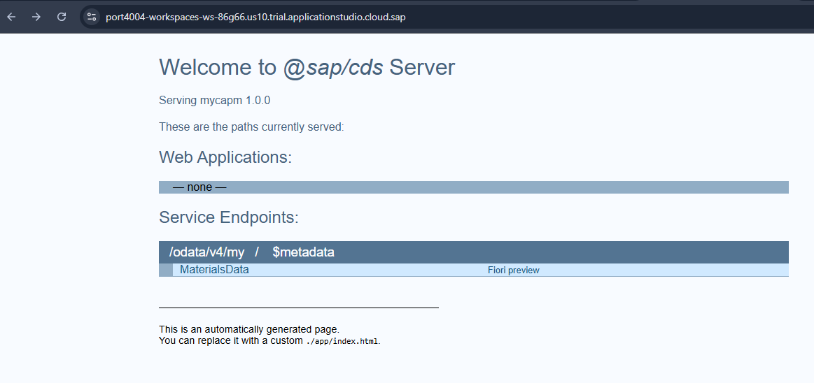
CAPM Application Default index page:
Click on the created service to see the response:

Slide 15
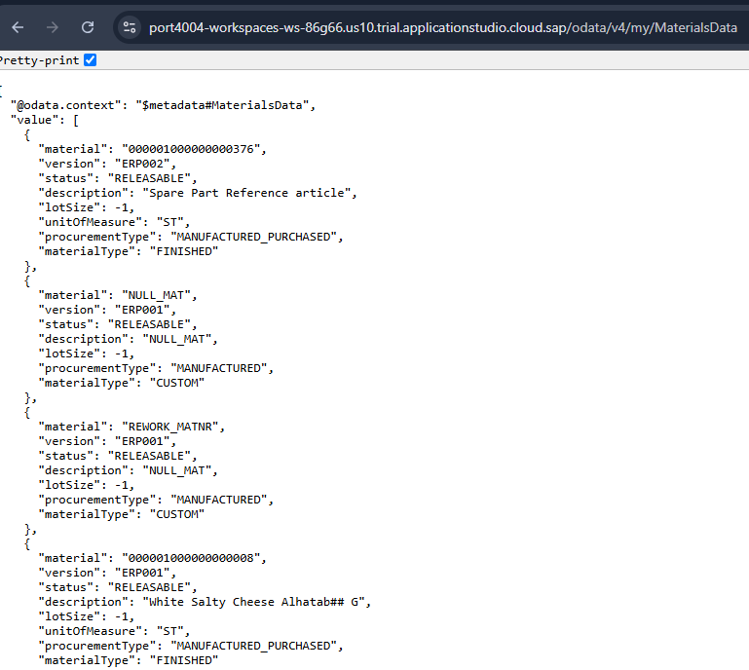
Response:
Once click the service it will display the response like below:

